Slide 1
HW3: Adder & Subtractor Practice

Slide 2
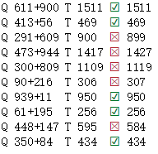
Outlines
Data Representation
Data Generation
Feature Engineering
String Matching
…

Slide 3
Data Representation
char vocabulary : “0, 1, 2, 3, 4, 5, 6, 7, 8, 9, +/-, ‘ ’”
the problem about considering the length of sequence
one-hot encoding
digital_tokens decoding

Slide 4
Data Generation
Generate some question-answer pairs for training and validating, like:

Slide 5
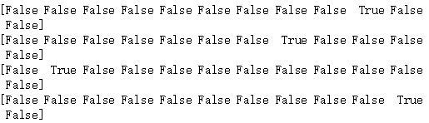
Feature Engineering
Transfer the training sets to one-hot representation.
[0, 1, 2, 3, 4, 5, 6, 7, 8, 9, +/-, ‘ ’]

Slide 6



Feature Engineering
Build our own model to fit relevance between questions and answers.

Slide 7
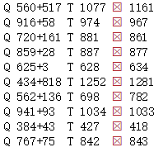
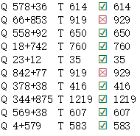
String Matching
When we train our model with the generated datasets, the matching accuracy will gradually increase.
Example:
Epoch 1
Epoch 98

Slide 8

Extension Problem
More digits per number ?
More numbers added ?
……
Sample Code Here
https://github.com/IKMLab/Adder-practice

Slide 9
Homework 3
Coding part
Write subtractor (A – B, A, B:3 digits, A>=B)
Try to combine adder and subtractor together
Report part
Analysis the results under different number of digits, training epoch, training size, etc
Can we apply the same training approach for multipliction?

